Slide 1

ECEN 461
Real-Time and Embedded Systems
IOT – Information – Sampling II

Slide 2
Agenda
Opening Prayer/Thought
Quick Review – Normalized Frequency
Analog To Digital Conversion
  Reconstruction from samples
  Smooth Interpolation
Digital To Analog Conversion
  Reconstruction from samples
  Smooth Interpolation
Sample Rate Conversion
    Decimation and Interpolation

Slide 3
Typical DSP System
x(t)
A-to-D
x[n]
COMPUTER
y[n]
D-to-A
y(t)
What is the spectrum of x(t) = Acos(2π(100)t+φ)
If x(t) has this spectrum, what is the spectrum of x[n]? How do we find it?
Normalized Frequency
–100
0
100
f (in Hz)

Slide 4
Spectrum Example
For x(t) = Acos(2π(100)t + φ)
What is x[n] when f_{s} = 1000Hz?
  x[n] = Acos(2πn(100/1000)+φ)
  x[n] = Acos(0.2πn+φ)
What are the fundamental frequencies of x[n]?
  Freq’s @ 0.2π and -0.2π
What are the Aliases of x[n]?
  {2.2π, 4.2π, 6.2π, …} & {-1.8π,-3.8π,…}
  {1.8π,3.8π,5.8π,…} & {-2.2π, -4.2π …}

Slide 5
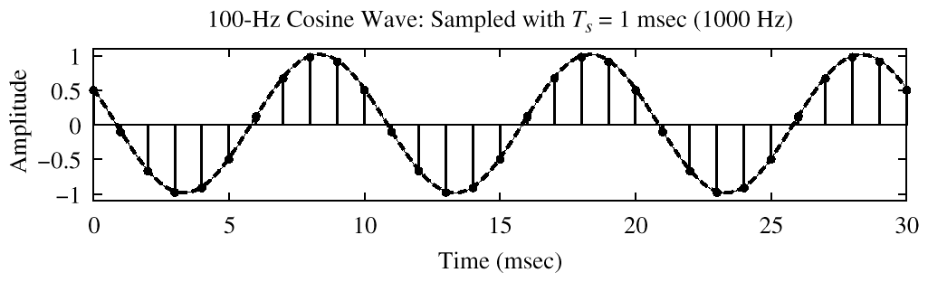
Digital Spectrum Example
–1.8π
–0.2π
2π(0.1)
1.8π

Slide 6
Nyquist Rate
What does Nyquist/Shannon tell us we need to do?
  Have to sample at least 2x highest frequency in signal

Slide 7
Sampling and Aliasing Demo
Lecture7Spring10.m
Example of sampling and aliasing
  Original sound is 5khz tone
  Sampled at
    44100 Hz
    22050 Hz
    11025 Hz
    8000 Hz

Slide 8
Signal Types
x(t)
A-to-D
x[n]
COMPUTER
y[n]
D-to-A
y(t)
What is the highest freq in audio signals?
  Audio < 20kHz
  Audio is an example of a Bandlimited Signal
What is the freq in a square (or triangle) wave?
  Square wave (or triangle wave) has infinite frequency in its spectrum
  Example of Non-Bandlimited Signal
How can we sample a non-bandlimited signal?
  Filter the input signal x(t)

Slide 9
What does this circuit do?
R
C
It is a simple RC Low Pass Filter
What is the Transfer Function of this filter?

Slide 10
RC Low Pass Filter
R
C
0
3dB
-10
-20
What do these really mean?

Slide 11
RC Low Pass Filter
R
C
0
3dB
-10
-20
If the input is a sinusoid with freq < ω₀, the output will be?
  a sinusoid with
    a magnitude that is the same as the input
    a phase change from the input per the phase equation
If the input is a sinusoid with freq > ω₀, the output will be?
  a sinusoid with
    a magnitude that is attenuated per the mag equation
    a phase change from the input per the phase equation

Slide 12
General DSP System
x(t)
Anti-
Aliasing
Filter
x_{f}(t)
A-to-D
x[n]
COMPUTER
y[n]
D-to-A
y(t)
This is what our system really needs to look like
What is the cutoff freq of the anti-aliasing filter need to be? What is an acceptable roll-off of the filter need to be?
  Cutoff needs to be at least ½ the sample rate
  Rolloff needs to ensure high freq components do not cause too much distortion

Slide 13
General DSP System
x(t)
Anti-
Aliasing
Filter
x_{f}(t)
A-to-D
x[n]
COMPUTER
y[n]
D-to-A
y(t)
D-to-A Reconstruction
  Create continuous y(t) from y[n]
    Mathematically
      If you have formula for y[n]
    Replace n with f_{s}t
    y[n] = Acos(0.2πn+φ) with f_{s} = 8000 Hz
    y(t) = Acos(2π(800)t+φ)
What does the output of a DAC look like?

Slide 14
Sample and Hold Device
Convert y[n] to y(t)
  y[k] should be the value of y(t) at t = kT_{s}
  Make y(t) equal to y[k] for
    kT_{s} -0.5T_{s} < t < kT_{s} +0.5T_{s}
y[k]
Stair-Step Approximation
y(t)
t
kT_{s}
(k+1)T_{s}

Slide 15
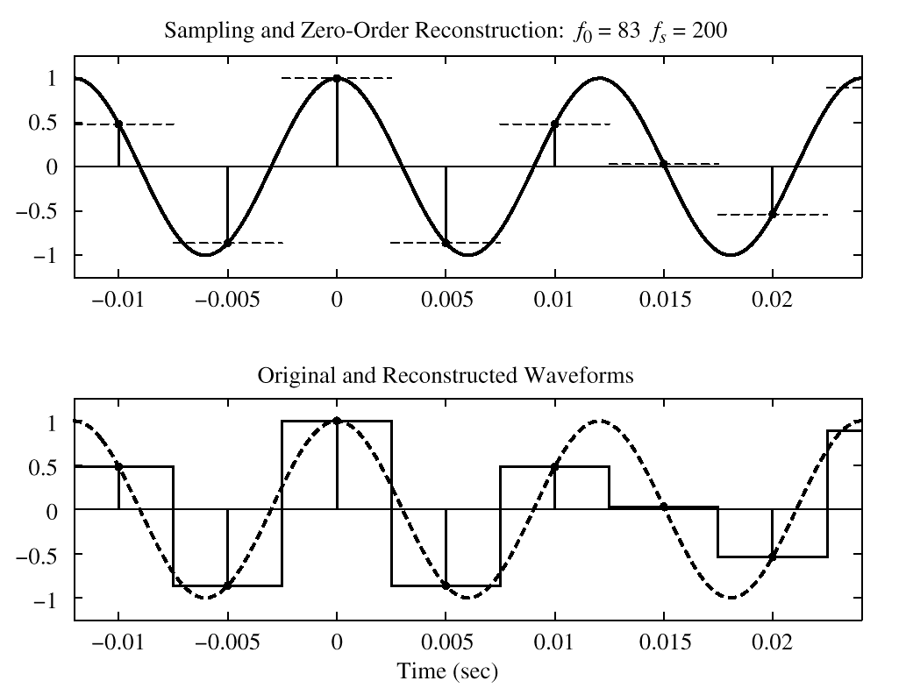
Sample and Hold Case

Slide 16
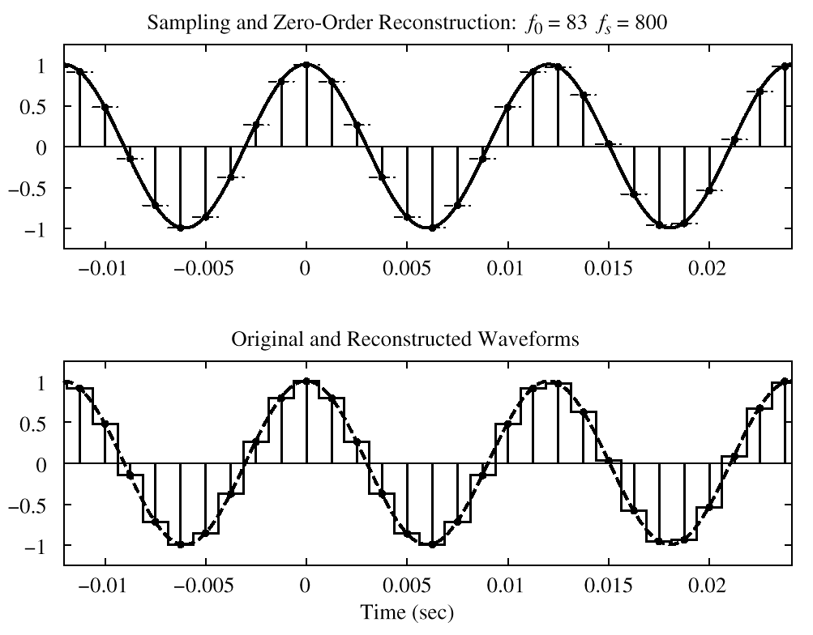
Over-Sampling Case
EASIER TO RECONSTRUCT

Slide 17
General DSP System
So, if the output of the DAC looks like this, what should we do?
What kind of filter should this be?
  Low Pass
x(t)
Anti-
Aliasing
Filter
A-to-D
x[n]
COMPUTER
y[n]
D-to-A
Smoothing
Filter
y(t)

Slide 18
Switch Gears
Real life problem
CD’s are sampled at 44.1kHz
Some audio players only handle data at 22kHz rates
What happens if we play the CD at 22kHz?
  Slooooow Music
  Lecture7aSpring10.m
So, how can we change the sample rate of a song?
2 Techniques
  Decimation – Process of reducing the sampling rate
  Interpolation – Process of increasing the sampling rate

Slide 19
Downsampling
Downsampling - the process of reducing the sampling rate of a signal by an integer number
  Simply a matter of picking every i^{th} sample in the sequence and discarding the rest
  What would be the Matlab code to do this?
  Lecture7bSpring10.m

Slide 20
Sampling x(t)
Reminder, in the time domain, what do we need prior to the inputting a signal into an ADC?
  Anti-Aliasing (analog low pass) Filter
  Why?
  We need to do the same when we downsample a signal to ensure we do not alias the downsampled signal
    This needs to be a digital filter though – not analog
x(t)
?
Filter
A-to-D
x[n]

Slide 21
Decimation
x₁[n]
?
Filter
Down
Sample
x₂[n]
Decimation - Combination of pre-filtering and down-sampling a signal
  Process of “sampling” a digital signal
  If we do not do this, high freq components can/will distort desired signal (just like sampling in the first place)
  Lecture7cSpring10.m

Slide 22
Higher rate?
CD’s are sampled at 44.1kHz
What if we wanted to play the CD on an audio players that only handle datas at 88.2kHz rates?
Upsampling - the process of increasing the sampling frequency of a signal by an integer number. How can we do this?

Slide 23
Upsampling Options
Option 1 – Repeat Values
Option 2 – Linear Interpolation
Option 3 – Derivative (slope) Interpolation
Computationally, how expensive are each of these?

Slide 24
Interpolation
x₁[n]
?
Up
Sample
Filter
x₂[n]
Interpolation
      Insert 0’s between successive samples
      Post filter the signal so it will not have sharp discontinuities
      Same effect as derivative interpolation, however much more computationally efficient
  Lecture7dSpring10.m

Slide 25
Upsampling Options
Step 1 – Insert Zeros
Step 2 – Post Filter (use digital filter)
Effect is same as derivative interpolation

Slide 26
Backup

Slide 27
Folding (a type of Aliasing)
EXAMPLE: 3 different x(t); same x[n]

Slide 28
Frequency Domains
x(t)
A-to-D
x[n]
y[n]
D-to-A
y(t)

Slide 29
Reconstruction (D-to-A)
How does a D/A Convert a stream of numbers to y(t)?
  “Connect The Dots”?
  Interpolation?
INTUITIVE,
conveys the idea
y[k]
y(t)
t
kT_{s}
(k+1)T_{s}

Slide 30
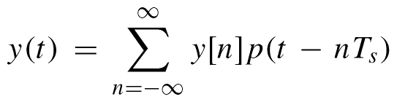
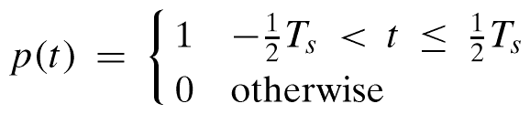
Math Model for D-to-A
Square Pulse:

Slide 31
Expand the Summation
Sum of Shifted Pulses p(t-nT_{s})
  “Weighted” by y[n]
  Centered at t=nT_{s}
  Spaced by T_{s}
    Restores “Real Time”

Slide 32
Sample and Hold Case
So, how close is this sample and hold (or square) pulse to the original?

Slide 33
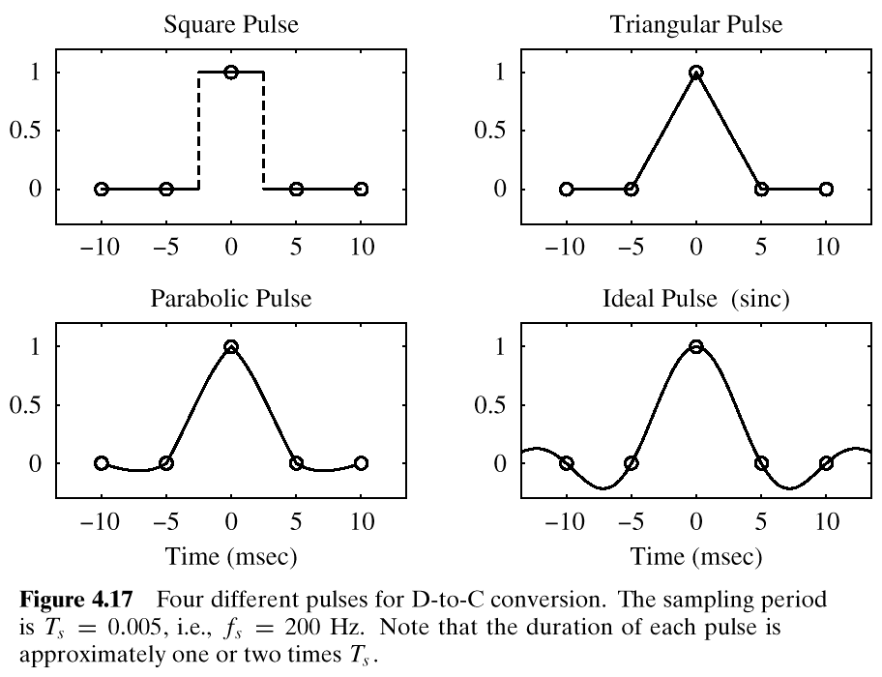
DAC Output Pulse Shapes
p(t)

Slide 34
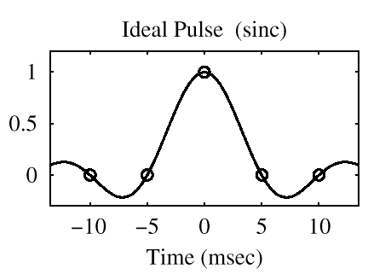
Optimal Pulse
Called “Bandlimited
Interpolation”

